Slide 1

Computer Architecture

Slide 2
Hardware
Hardware:
Safety
Data measurement and transfer
Motherboard and CPU

Slide 3

Data Measurement and Transfer
Data Measurement:
If you are storing text-only information in the computer, each character of that text (including spaces and punctuation marks) equals a byte
To calculate the number of bytes in the following sentence, count the letters, numbers, spaces, and punctuation marks:
From this scale, you can see that the sentence uses 44 bytes.
You can prove this to yourself by starting up Windows Notepad and entering the text just as you see it printed here. Save the text as EXAMPLE.TXT and view the File properties. You'll see that the text is exactly 44 bytes.

Slide 4
Data Measurement and Transfer
Do most computer programs store just the text when you write something?
To find out, start up a word-processing program, such as Windows WordPad or Microsoft Word. Enter the same sentence again, and save it as EXAMPLE.RTF if you use WordPad, and EXAMPLE.DOC if you use Microsoft Word .
Depending upon the exact version of WordPad or Microsoft Word you use, the file takes up much more space. For example, WordPad for Windows XP saves text as an RTF file, using 243 bytes to store the file. The same sentence takes 19,968 bytes when saved as a .DOC file by Microsoft Word XP!
What happened? The next section explains this apparent oddity.

Slide 5
Data Measurement and Transfer
File Overhead and Other Features:
When data you create is stored in a computer, it must be stored in a particular arrangement suitable for the program that created the information. This arrangement of information is called the file format.
A few programs, such as Windows Notepad, store only the text you create. What if you want to boldface a certain word in the text? A text-only editor can't do it. All that Notepad can store is text. As you have seen, in text-only storage, a character equals a byte.
In computer storage, however, pure text is seldom stored alone. WordPad and other word-processing programs such as Microsoft Word enable you to boldface, underline, italicize, and make text larger or smaller. You can also use different fonts in the same document.

Slide 6
Data Measurement and Transfer
Most modern programs also enable you to insert tables, create columns of text, and insert pictures into the text, and have provisions for tracking changes made by different users. In other words, there's a whole lot more than text in a document.
To keep all this non-text information arranged correctly with the text, WordPad and other programs must store references to these additional features along with the text, making even a sentence or two into a relatively large file, even if none of the extra features is actually used in that particular file.
Thus, for most programs, the bytes used by the data they create is the total of the bytes used by the text or other information created by the program and the additional bytes needed to store the file in a particular file format.

Slide 7
Data Measurement and Transfer
Binary Versus Decimal MB/GB:
Although a byte represents the basic "building block" of storage and RAM calculation, most measurements are better performed with multiples of a byte.
All calculations of the capacity of RAM and storage are done in bits and bytes.
Eight bits is equal to one byte.
The following provides the most typical values and their relationship to the byte.

Slide 8
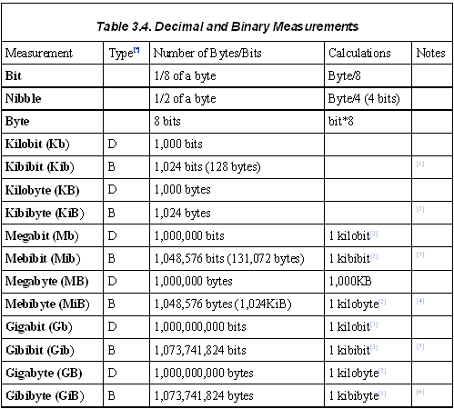
Data Measurement and Transfer

Slide 9
Data Measurement and Transfer
Until December 1998, the terms kilobit, kilobyte, megabit, megabyte, gigabit, and gigabyte were officially used to refer both to decimal and binary values.
A great deal of confusion in the industry has been caused by the indiscriminate use of both types of measurements for hard disk storage.
Although the binary multiples shown in the previous table are an IEC standard, many vendors in the computer business don't yet use the term kibibits or other binary multiples yet.

Slide 10
Data Measurement and Transfer
Serial Versus Parallel Information Transfer:
Information flows through the computer in many ways. The CPU is the central point for most information. When you start a program, the CPU instructs the storage device to load the program into RAM. When you create data and print it, the CPU instructs the printer to output the data.
Because of the different types of devices that send and receive information, two major types of data transfers take place within a computer: parallel and serial.

Slide 11
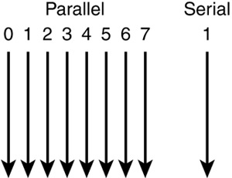
Data Measurement and Transfer

Slide 12
Data Measurement and Transfer
Parallel transfers use multiple "lanes" for data and programs, and in keeping with the 8 bits = 1 byte nature of computer information, most parallel transfers use multiples of 8.
Parallel transfers take place between the following devices:
  CPU and RAM
  CPU and interface cards
  LPT (printer) port and parallel printer
  SCSI port and SCSI devices
  ATA/IDE host adapter and ATA/IDE drives
  RAM and interface cards (either via the CPU or directly with DMA)

Slide 13
Data Measurement and Transfer
Why are parallel transfers so popular?
  Multiple bits of information are sent at the same time.
  At identical clock speeds, parallel transfers are faster than serial transfers because more data is being transferred.

Slide 14
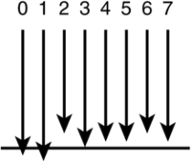
Data Measurement and Transfer
However, parallel transfers also have problems:
  Many wires or traces (wire-like connections on the motherboard or expansion cards) are needed, leading to interference concerns and thick, expensive cables.
  Excessively long parallel cables or traces can cause data to arrive at different times. This is referred to as signal skew
  Differences in voltage between wires or traces can cause jitter.

Slide 15
Data Measurement and Transfer
As a result of these problems some compromises have had to be included in computer and system design:
  Short maximum lengths for parallel, ATA/IDE, and SCSI cables
  Dual-speed motherboards (running the CPU internally at much faster speeds than the motherboard or memory)
Fortunately, there is a second way to transmit information: serial transfers.

Slide 16
Data Measurement and Transfer
Serial Information Transfer:
Serial transfers have the following characteristics:
  One bit at a time is transferred to the device.
  Transmission speeds can vary greatly, depending on the sender and receiver.
  Very few connections are needed in the cable and ports (one transmit, one receive, and a few control and ground wires).
  Cable lengths can be longer with serial devices. For example, an UltraDMA/66 ATA/IDE cable can be only 18 inches long for reliable data transmission, whereas a Serial ATA cable can be almost twice as long.

Slide 17
Data Measurement and Transfer
Although RS-232 serial ports are slow, newer types of serial devices are as fast or faster than parallel devices. The extra speed is possible because serial transfers don't have to worry about interference or other problems caused by running so many data lines together.

Slide 18
Motherboard and CPU
The Motherboard:
The motherboard represents the logical foundation of the computer
  In other words, everything that makes a computer a computer must be attached to the motherboard. From the CPU to storage devices, from RAM to printer ports, the motherboard provides the connections that help them work together.
  Take a close look at a motherboard, and you’ll see fine copper-colored wire traces on the top and bottom that run between different parts of the mother board. These wire traces are portions of the motherboard’s bus structure.

Slide 19
Motherboard and CPU
The motherboard is essential to computer operation in large part because of the two major buses it contains: the system bus and the I/O bus. Together, these buses carry all the information between the different parts of the computer.

Slide 20
Motherboard and CPU
Essential Components found on all Motherboards
CPU (Central Processing Unit)
  “The brains of the computer” → dedicated socket or slot (might be soldered in place).
RAM (Random Access Memory)
  Programs are loaded into this for operating; data resides here until saved to storage device → Dedicated slots
ROM (Read Only Memory)
  Firmware containing drivers for standard devices; power-on self-test → dedicated socket, most common ROM is BIOS ROM
If BIOS settings are stored
in ROM, which is not volatile
why does removing the
BIOS battery effect the BIOS
settings

Slide 21
Motherboard and CPU
Keyboard Connector
  Used to connect a keyboard → Soldered
CMOS RTC chip
  Records the BIOS Settings; keeps the date and time → soldered
Battery
  Maintains the contents of the CMOS / RTC chip.

Slide 22
Motherboard and CPU
Cache RAM
  Holds a copy of the last memory locations read for faster performance → dedicated socket or surface mounted
Expansion Slots
  These enable expansion of the computer’s capabilities → soldered in place.
BIOS chip
  Chip that contains setup options and performs a POST (power-on self-test) at each bootup.

Slide 23
Motherboard and CPU
What components are fastest
inside your PC?
Recognising Expansion Slots:
ISA (Industry standard Architecture)
  The oldest slot type is ISA (1981)
  ISA slots come in two forms: a slot with a single long connector, which can send or receive 8 bits of data, and a 16-bit or AT-style slot, which adds a shorter connection in line with the original connector.
  ISA slot is now considered obsolete
Cache Memory
Main Memory
Cards in Expansion slots

Slide 24
Motherboard and CPU
PCI (Peripheral Component Interconnect, around 1993 - 1994)
  replaced VL-Bus slots (a 32-bit version of the ISA slot) in both late-model 486 based machines and in most Pentium-class computers.
AGP (Accelerated Graphics Port 1996)
  Intel developed the Accelerated Graphics Port, or AGP slot, in 1996 strictly for high-speed video
  All types of AGP slots can temporarily “borrow” system memory when creating 3Dtextures.
  There are several variations on the AGP slot in use, depending upon the age of the system and the intended use of the system

Slide 25
Motherboard and CPU
Motherboard Types
There are several basic motherboard designs:
    Baby-AT
    LPX
    ATX family (ATX, Micro-ATX, Flex-ATX, Mini-ITX)
    NLX
  Note: The most common of these in recent systems include the ATX family and the NLX. The others (Baby-AT and LPX) are found primarily in older systems that are obsolete

Slide 26
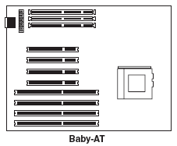
Motherboard and CPU
Baby –AT models
Baby-AT models have expansion slots, which run parallel to the long edge of the motherboard. Built-in mouse, serial, parallel, and USB ports (if present) require header cables to be run between the ports on the motherboard and the rear of the case. Most Baby-AT motherboards use a 12-pin power connector.

Slide 27
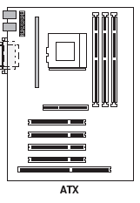
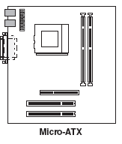
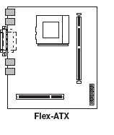
Motherboard and CPU
ATX-Family
ATX-family motherboards have expansion slots that run parallel to the short edge of the motherboard. They have a two-row cluster of ports on the rear of the motherboard. ATX motherboards use a 20-pin power connector.

Slide 28
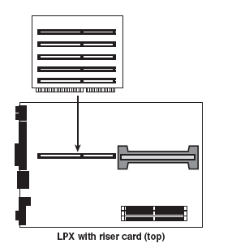
Motherboard and CPU
LPX
LPX motherboards have a proprietary riser card running from the middle of the motherboard. Some use a vertical riser card as shown in Figure 4.6, in which add-on cards are parallel to the motherboard, whereas others use a T-shaped riser card in which add-on cards are at the normal 90- degree angle to the motherboard. LPX motherboards have a single row of built-in ports along the rear edge of the motherboard. LPX motherboards use the same power connector as Baby-AT motherboards.

Slide 29
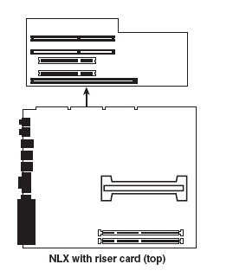
Motherboard and CPU
NLX
NLX motherboards also use a riser card, but the motherboard connects to the riser card along the right edge (as viewed from the front). NLX motherboards have a two-row cluster of ports along the rear edge of the motherboard. NLX motherboards are powered by the riser card connector.

Slide 30
Motherboard and CPU
The CPU (Central Processing Unit):
One of the most important components found on any motherboard is the CPU, or central processing unit. The CPU is the brains of the computer, requesting information from devices, modifying and creating information, and then sending information to devices.

Slide 31
Motherboard and CPU
Core Voltage
The core voltage is the voltage that the motherboard feeds to the processor.
The core voltage depends on the clock speeds and design revisions for typical motherboards.

Slide 32
Motherboard and CPU
Internal CPU characteristics Affecting Performance
The register size and data bus—These refer to the width of data that can be accessed in each CPU operation; the register size refers to data management inside the CPU, whereas the data bus refers to data transfer between the CPU and RAM. Some CPUs have a bottleneck created by having a data bus narrower than the register size; having a data bus wider than the register size increases speed by enabling the CPU to perform two data-transfer operations at the same time.

Slide 33
Motherboard and CPU
The presence or absence of a math co-processor circuit to perform faster floating point math (used by CAD and spreadsheet programs)—Although most CPUs prior to the Pentium used a separate math co-processor, the Pentium and all newer CPUs have a built-in math co-processor.
The amount of RAM the CPU can access—Larger amounts are better, although the actual motherboard design limits most systems to far less RAM than the CPU can use.

Slide 34
Motherboard and CPU
The presence or absence of cache RAM (RAM that holds a copy of main memory for faster access by the CPU)—L1 cache is part of the CPU itself; Level 2 cache is found in various locations. Small L2 cache sizes or no L2 cache at all slows down the system.
The amount and speed of cache RAM—Larger and faster cache RAM improves system speed, especially for operations that take place entirely or primarily in RAM.

Slide 35
Motherboard and CPU
Increasing Memory size and speed
CPU performance can be optimized through the following system upgrades:
  Increasing the size of installed memory
  Using faster memory (if supported by the processor and motherboard)
  Upgrading to a processor with faster clock speed and larger L2 cache

Slide 36
Motherboard and CPU
Installing more memory is the easiest way to improve the performance of any system. Increasing RAM memory in the system optimizes CPU performance by providing a larger pool from which to draw program code and data. Inadequate RAM forces the CPU to request the correct information from storage devices, which are much slower than RAM.

Slide 37
Motherboard and CPU
Processor Cooling
Most processors require a heatsink for cooling. A heatsink is a finned metal device (occasionally plastic on very old processors) that radiates heat away from the processor. In almost all cases, an active heatsink (a heatsink with a fan) is required for adequate cooling, unless the system case is specially designed to aim air directly over the processor.
Although aluminum has been the most common material used for heatsinks, copper has better thermal transfer properties, and is frequently specified for processors faster than 1.5GHz. Some active heatsinks use a copper contact plate along with a larger-than-normal aluminum cooling area instead of an all-copper design to support faster processors (which normally produce more heat than slower models) at a cost lower than that of an all-copper design.

Slide 38
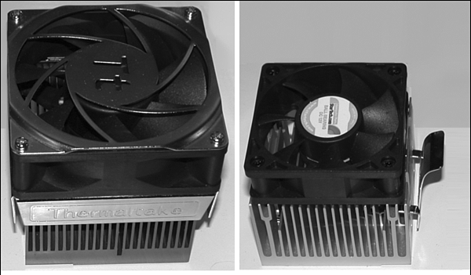
Motherboard and CPU
A large active heatsink with a copper contact plate (left) compared with a smaller, all aluminum Version (right). The larger model is designed for faster, hotter processors.

Slide 39
Motherboard and CPU
Most active heatsinks for recent processors plug into a processor fan connection on the motherboard. The 3-pin connection enables the system BIOS to monitor fan revolutions. Many recent systems also monitor processor temperature. The cooler the processor runs, the more efficient it is and the lower the risk of instability and system crashes due to overheating.

Slide 40
Motherboard and CPU
Liquid cooling systems
Liquid cooling systems attach a liquid cooling unit instead of an active heatsink to the processor.
A pump moves the liquid (which might be water or a special solution, depending upon the cooling system) through the computer to a heat exchanger, which uses a fan to cool the warm liquid and back to the processor.
Liquid cooling systems are designed primarily for very high performance systems, especially overclocked systems.

Slide 41
Motherboard and CPU Short Quiz
What are the main components found on a typical motherboard?
How can motherboards be categorised and thus be identified?
What is the most common motherboard family?
What is the most important component on a motherboard?
How does a liquid cooling system work?
How does increasing RAM optimize CPU performance?
What is meant by core voltage?
List four types of motherboards.

Slide 42
Motherboard and CPU Short Quiz
The motherboard is the heart of the computer because it contains connectors for the CPU, main and cache RAM, I/O ports, and expansion slots.
Motherboards can be categorized by their shape, the presence of I/O ports, their processor, and the type (s) of expansion slots they use.
The most common motherboard family today is the ATX family.
The most important part of the motherboard is the CPU or processor.
A pump moves the liquid (which might be water or a special solution, depending upon the cooling system) through the computer to a heat exchanger, which uses a fan to cool the warm liquid and back to the processor.
Increasing RAM memory in the system optimizes CPU performance by providing a larger pool from which to draw program code and data.

Slide 43
Motherboard and CPU Short Quiz
The core voltage is the voltage that the motherboard feeds to the processor.
LPX, ATX, NLX and Baby - AT

